Slide 1
Social Network Analysis & Visualisation #SHDB17 Ellen König, Syennie Valeria, Thomas Beutin
Notes:
11/19/17
1
1

Slide 2


Slide 3
WHAT?

Slide 4
DATA
MUSIC

Slide 5
HOW?

Slide 6
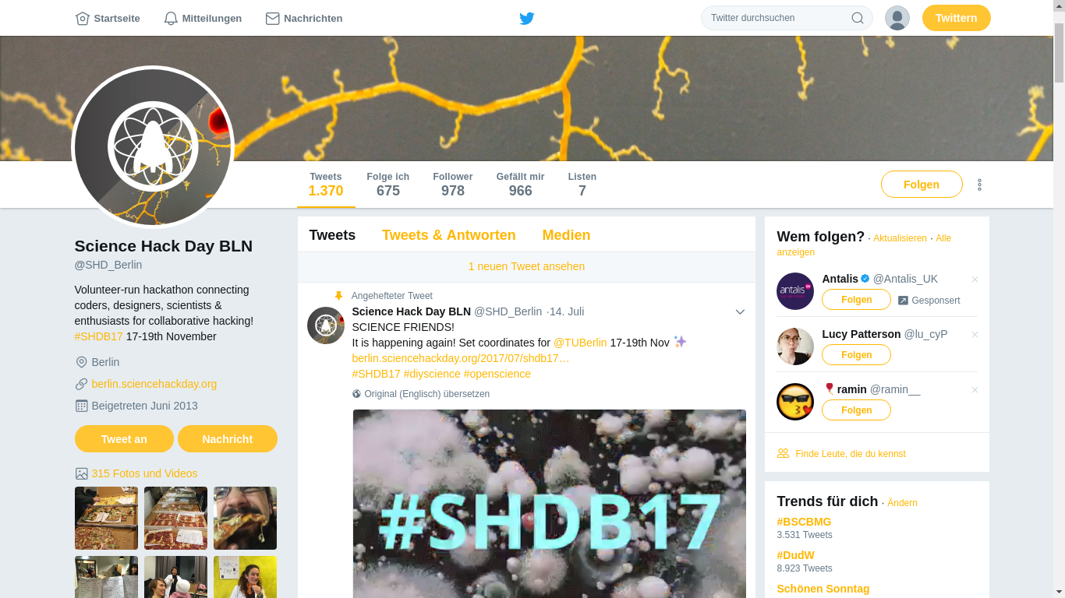
Notes:
11/19/17
6
6

Slide 7
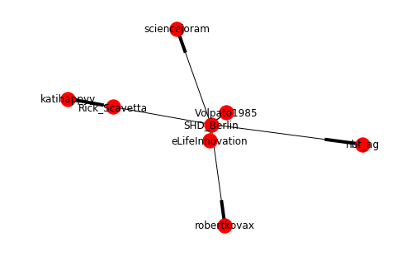
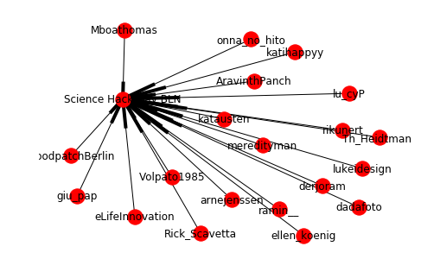
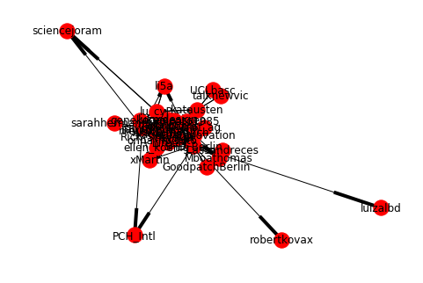
Notes:
11/19/17
7
7

Slide 8
Notes:
11/19/17
8
8

Slide 9
Betweenness Centrality
Closeness Centrality
Out-Degree Centrality
In-Degree Centrality

